Slide 1
MLOPs For Prediction for Autism Spectrum Disorder (ASD)
Johnathan Long, Arup Chakraborty and Joseph Friedel
Notes:
Aryaz starts

Slide 2
Abstract/Overview
Primary Aim: To develop an MLOps tool that accelerates the early identification of individuals at high risk for Autism Spectrum Disorder (ASD), ensuring they are fast-tracked for full clinical assessment.
Key Goals:
Build a Predictive Model:
Construct a robust binary classification model to predict ASD likelihood from screening data.
Create a Scalable MLOps Pipeline:
Implement an end-to-end MLOps workflow on AWS (S3, Glue, SageMaker) to support scalable data management, training, and future deployment.
Deploy the model
Monitor the model deployment matrices
Monitor the logs using Sagemaker cloud watch
Monitor the model drift and feature drift

Slide 3
Abstract/Overview
Code attempts to
Data Ingestion & Warehousing:
Loads raw screening data and uploads it to an AWS S3 bucket.
Uses AWS Glue to crawl the data and create a data catalog.
Transforms the data into the efficient Parquet format for querying with Amazon Athena.
Centralized Feature Management:
Establishes a SageMaker Feature Store to create a single source of truth for ML features.
Populates the Feature Store, making features consistently available for both model training (offline) and real-time predictions (online).
Data Analysis & Preprocessing:
Performs Exploratory Data Analysis (EDA) to uncover relationships between demographic/screening features and ASD diagnoses.
Prepares the data for model consumption.

Slide 4
Overview of Dataset
Dataset Source & Structure
Source: The project utilizes data from ASD screening questionnaires, provided in train.csv and test.csv files.
Type: Tabular data combining clinical screening responses and patient demographics.
Target Variable: A binary feature named 'Class/ASD', where 1 indicates a clinical diagnosis of ASD and 0 indicates no diagnosis.
Feature Categories
Screening Scores (Behavioral Traits):
A1_Score to A10_Score: These are the core features, representing binary answers (0 or 1) to 10 questions from the Autism-Spectrum Quotient (AQ-10) screening tool.
Demographic & Background Information:
age: Patient's age in years.
gender: Patient's gender.
ethnicity: Patient's ethnic background.
jaundice: A binary indicator of whether the patient had jaundice at birth.
autism: A binary indicator for a family history of autism.
country_of_res: Patient's country of residence.
used_app_before: Indicates if the user has used the screening app before.
relation: Who is filling out the screening form (e.g., 'Self', 'Parent').

Slide 5
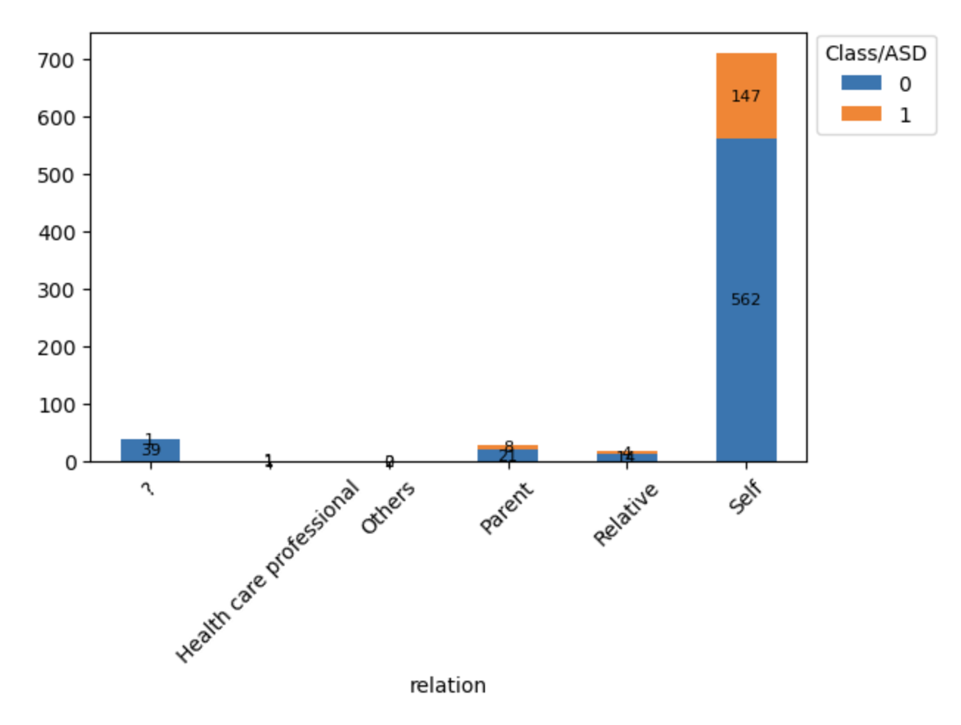
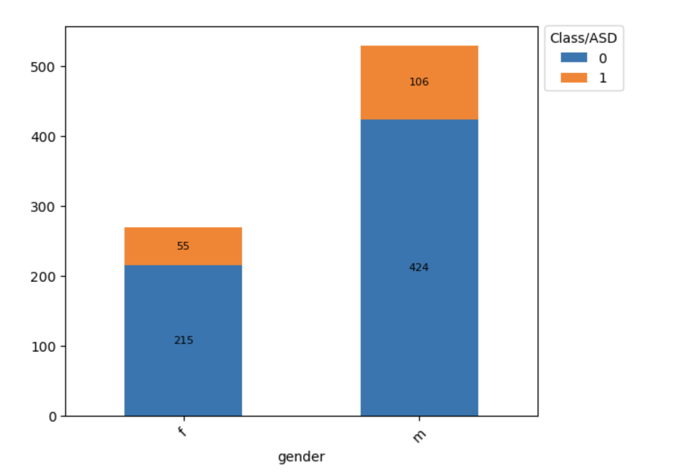
Data Pipeline - From S3 to Visualization
S3 as Primary Storage:
The raw train.csv and test.csv files are first uploaded to an Amazon S3 bucket. S3 provides a durable and scalable foundation for our data lake.
Data Transformation for Efficiency:
The data is then converted from CSV to Apache Parquet format. Parquet is a columnar storage format optimized for fast analytical querying, reducing costs and improving performance.
Creating a Data Catalog with AWS Glue:
An AWS Glue Crawler is run on the S3 data.
Glue automatically infers the data schema (column names, data types) and creates a metadata table in the AWS Glue Data Catalog. This makes our S3 data discoverable and queryable like a traditional database.
Plotting Diagrams for EDA
Bar Charts: To compare categorical data, such as the count of ASD cases across different ethnicities or genders.
Histograms & Boxplots: To understand the distribution of numerical features like age.
Correlation Heatmaps: To visualize the relationships between all the A_Score features and the ASD diagnosis.
Notes:
Arup starts

Slide 6
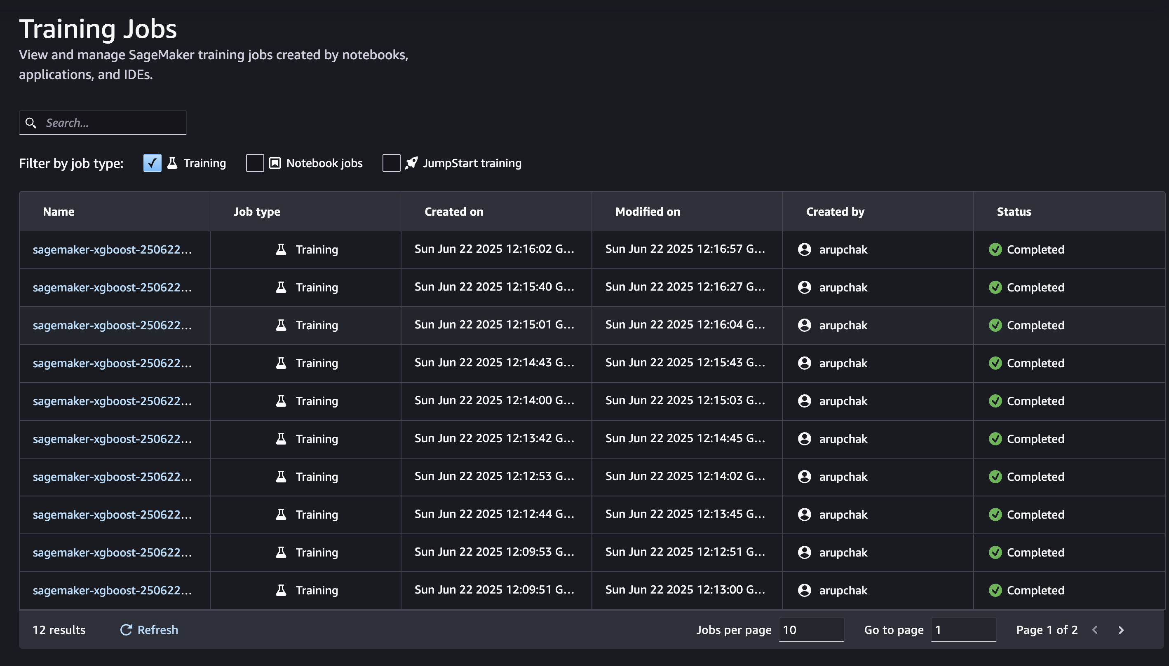
Methods - Model Training & Evaluation with XGBoost
Data Source: The model is trained using data retrieved directly from the SageMaker Feature Store, ensuring consistency between training and inference.
SageMaker Estimator: A SageMaker Estimator for XGBoost is configured, specifying:
The location of the training and validation data.
Hyperparameters for the model (e.g., max_depth, eta, gamma, subsample).
The instance type and count for the training job.
Training Job: The .fit() method is called on the estimator, which launches a managed training job on AWS. SageMaker handles the provisioning of resources, training the model, and storing the resulting model artifacts in S3.

Slide 7
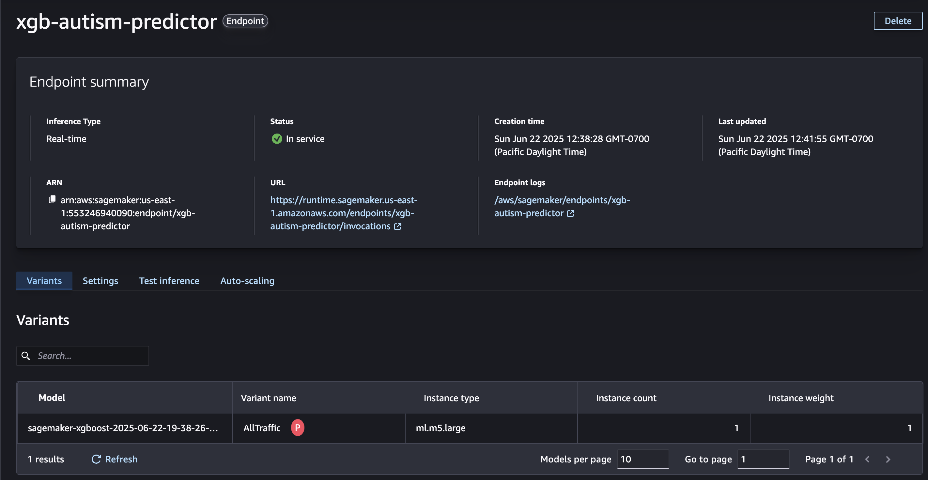
Model Deployment & Real-Time Inference
The ultimate goal of the MLOps pipeline is to make the trained model available for real-time use. This is achieved by deploying it to a managed, scalable endpoint.
Step 1: Creating a SageMaker Endpoint
Deploy Command: After the XGBoost model is successfully trained, the SageMaker estimator.deploy() method is called.
What deploy() Does:
Takes the trained model artifacts (stored in S3).
Creates a SageMaker Model object.
Defines an Endpoint Configuration, specifying the hardware (e.g., ml.t2.medium instance type) and scaling settings.
Provisions the necessary compute resources and deploys the model, exposing it via a secure HTTPS endpoint.
Step 2: Real-Time Inference
Invoking the Endpoint: Once deployed, the endpoint is ready to receive prediction requests. Applications can send new, unseen data (e.g., responses from a new screening questionnaire) to the endpoint.
Data Serialization: The input data must be serialized into a format the model understands (typically CSV or JSON).
Getting Predictions: The endpoint processes the input data using the deployed model and returns a prediction in real-time. For this project, the prediction would be the probability score of the individual having ASD.

Slide 8
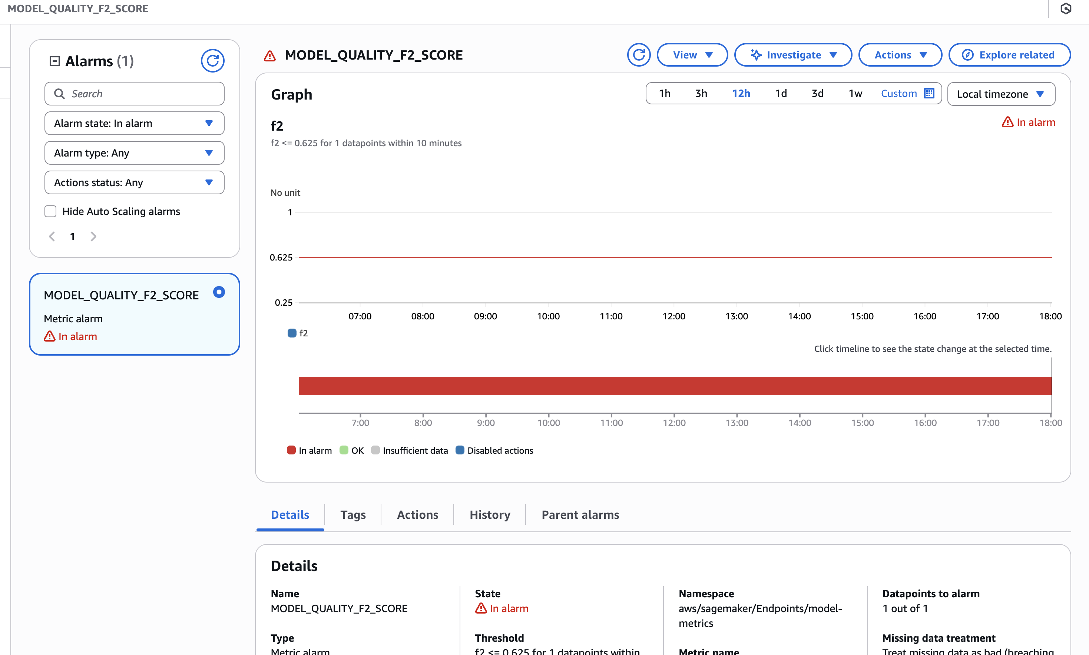
Setup Model Monitoring with SageMaker Model Monitor
Automated Monitoring: Amazon SageMaker Model Monitor provides the tools to automatically watch over the deployed model.
Steps:
Establish a Baseline: A baseline is created from the training data, defining the expected statistical properties and schema of the data.
Capture Production Data: SageMaker captures a percentage of the real-time inference requests and responses from the live endpoint.
Compare and Detect Violations: The captured production data is periodically compared against the baseline. SageMaker automatically detects statistical drift in the data and degradation in model quality metrics (like recall and accuracy).
Alerting & Reporting: When violations are detected, Model Monitor generates reports (stored in S3) and can trigger Amazon CloudWatch Alerts.

Slide 9
Model & Feature Drift
Monitoring is an active, automated process using SageMaker Model Monitor to detect both data and model quality degradation.
Monitoring Feature Drift (Is the input data changing?)
Goal: To detect if the statistical profile of the data sent for prediction differs from the training data.
Implementation:
Create a Baseline: During training, a constraints.json file is created. This file defines the statistical baseline for every feature (e.g., the mean and standard deviation for age, the distribution of categories for ethnicity).
Capture Live Data: SageMaker is configured to capture a sample of the real-time inference requests sent to the deployed endpoint.
Scheduled Analysis: A periodic monitoring schedule (e.g., hourly or daily) runs a job that compares the captured live data against the baseline statistics.
Trigger: If the live data violates the baseline constraints (e.g., the percentage of a new country_of_res exceeds a threshold), a CloudWatch Alert is triggered. This signals that the model is seeing data it wasn't trained on.
Monitoring Model Drift (Is the model's performance degrading?)
Goal: To detect if the model's predictive quality (e.g., its recall) is decreasing on real-world data. This is the ultimate measure of drift.
Implementation:
Collect Ground Truth: This is the most critical step. A process must be in place to gather the actual outcomes (the true Class/ASD labels) for the predictions the model made. This often involves a time delay for clinical assessments to be completed.
Merge Predictions with Ground Truth: The collected ground truth labels are joined with the model's predictions that were captured by the endpoint.
Re-Calculate Quality Metrics: With both predictions and actual labels, we can re-calculate our key business metric, Recall, along with AUC, precision, etc., on the production data.
Trigger: The system compares the new, real-world recall score against the recall score from the original validation dataset. If performance drops below a predefined threshold, a CloudWatch Alert signals that the model's effectiveness has diminished and retraining is required.

Slide 10
Operational Health & Log Monitoring with CloudWatch
While Model Monitor watches the data, Amazon CloudWatch watches the system. It provides the operational visibility needed to ensure our entire MLOps infrastructure is healthy, performant, and secure.
What We Monitor: System & Application Logs
Centralized Logging: All AWS services used in this project, especially SageMaker, automatically stream detailed logs and performance metrics to CloudWatch.
Key Log Sources:
SageMaker Training Jobs: Logs from the training container, showing progress, errors, or resource bottlenecks during model training.
SageMaker Endpoints: Invocation logs, including application errors (4xx), server errors (5xx), and model latency. These are crucial for debugging real-time prediction failures.
System Metrics: CPU Utilization, Memory Utilization, and Disk I/O for the underlying endpoint instances.
How We Use CloudWatch for Proactive Monitoring
Real-time Debugging:
When a prediction fails, developers can instantly query CloudWatch Logs using specific request IDs to find the exact error message and traceback, dramatically reducing troubleshooting time.
Automated Alerting with CloudWatch Alarms:
We can create alarms that automatically trigger based on log patterns or metric thresholds.
Example Alarms:
High Error Rate: Trigger an alarm if the number of 5xx server errors from the endpoint exceeds 5 in a 1-minute period.
High Latency: Alert the team if the ModelLatency metric averages above 500ms for more than 5 minutes.
Resource Bottlenecks: Trigger an alarm if CPUUtilization on the endpoint instance remains above 90% for a sustained period, indicating a need to scale up.
Notes:
Jory continues: The CNN model, especially with transfer learning via the Xception architecture, shows potential for improving diagnostic accuracy in medical imaging, according to a comparison of the generated results with the body of current research.

Slide 11
Future Enhancements & Roadmap
To evolve this proof-of-concept into a more mature, production-grade clinical support tool, we propose the following enhancements across the MLOps lifecycle.
Model & Performance
Advanced Modeling Techniques:
Experiment with other sophisticated models like LightGBM or deep learning (Neural Networks) to potentially improve predictive accuracy and better capture complex interactions.
A/B Testing in Production:
Deploy multiple model versions simultaneously using SageMaker's production variants. Route a portion of live traffic to a new candidate model to compare its real-world performance against the current champion before full deployment.
Ensemble Modeling:
Combine the predictions from several different models to create a more robust and often more accurate final prediction.
Automation & MLOps Maturity
Full CI/CD/CT Pipeline:
Automate the entire MLOps workflow using tools like AWS CodePipeline and AWS Step Functions. A new code commit would automatically trigger testing, training, evaluation, and deployment, enabling Continuous Training (CT).
Automated Ground Truth Collection:
Develop a secure pipeline to automatically ingest verified clinical diagnoses back into the system to serve as ground truth data for ongoing model monitoring and retraining.
Feature Store Expansion:
Incorporate more complex, engineered features into the SageMaker Feature Store, such as interaction terms or features derived from NLP on clinical notes (if available).
Application & Usability
Develop a Clinician-Facing UI:
Build a secure web application for clinicians to input new patient data. The UI would display the model's prediction score along with explainability insights (e.g., a SHAP force plot) to show which factors most influenced the prediction, fostering clinical trust.
Integrate with Electronic Health Records (EHR):
Work towards integrating the tool with existing EHR systems to streamline the data entry process and make the screening tool a seamless part of the clinical workflow.
Notes:
Jory continues: Observations
The accuracy for model predictions depends on quite a few factors:
Data Quality and Quantity
More Data: Generally, more data leads to better model performance.
Data Augmentation: Techniques like rotation, scaling, cropping, and flipping can help the model generalize better by providing a more diverse set of training examples.
Balanced Dataset: We need to prevent the model from becoming biased toward more frequent classes.
Model Architecture
Depth of the Network: Adding more layers can help the model learn more complex patterns, but too many layers might lead to overfitting.
Hyperparameter Tuning: Optimizing hyperparameters, including the number of filters, kernel size, and activation functions, can significantly impact model performance.
Regularization Techniques
Dropout: Randomly dropping units from the neural network during training can prevent overfitting.
Weight Regularization: Adding L1 or L2 regularization to the model weights can also help prevent overfitting by penalizing large weights.

Slide 12
Summary & Final Thoughts
Project Summary
We have successfully designed and implemented an end-to-end MLOps pipeline on AWS for the early detection of Autism Spectrum Disorder.
The system ingests, processes, and stores data efficiently using a modern data lake architecture (S3, Glue, Athena).
A robust XGBoost model was trained and deployed using Amazon SageMaker, with a primary focus on maximizing recall to ensure at-risk individuals are not missed.
Crucially, we established a framework for continuous monitoring, incorporating SageMaker Model Monitor and CloudWatch to track feature drift, model degradation, and operational health.
Final Thoughts
This project demonstrates that the value is not just in the predictive model itself, but in the creation of a durable, automated, and scalable system. By focusing on the entire MLOps lifecycle—from data ingestion to monitoring—we have built a strong foundation.
The true impact of this work lies in its potential to serve as a real-world clinical decision support tool. By accelerating the identification process, this system can help reduce the workload on clinicians and, most importantly, shorten the time it takes for individuals to receive the critical assessment and support they need. The path forward involves refining this system and integrating it deeper into the clinical workflow to realize this potential.
Notes:
Our study has successfully showcased how advanced machine learning methods can accurately detect and categorize forms of brain tumors. The performance metrics included in the results section demonstrate the models' notable degree of accuracy. By comparing the precision, recall, and F1-scores of the tumor types "Notumor," "Glioma," "Meningioma," and "Pituitary," the model shows a high discriminatory power between them.
By graphically illustrating the frequencies of true positives and false positives, as well as highlighting the model's advantages and shortcomings, the confusion matrix verified the efficacy of the system. The training and validation loss and accuracy curves demonstrate how the rigorous training process allows the model to effectively learn from the data without overfitting.
The findings of this research significantly advance the ongoing efforts in the field of medicine to apply artificial intelligence to improve the precision and efficacy of brain tumor identification. By enabling quicker and more accurate treatment planning, this discovery may improve patient outcomes.
We believe that in order to increase precision and applicability of the predictions, future research should concentrate on expanding the dataset, adding a greater variety of brain tumor types, and investigating advanced machine learning and deep learning models. Moreover, the amalgamation of clinical and imaging data has promise in offering a holistic method for diagnosing and scheduling treatment. This suggestion aligns with the broad potential that deep learning presents in current research (Litjens, 2017). Furthermore, multimodal learning-enabled medical image analysis may be used to treat medical conditions other than brain tumors (Zhou, 2020).
In conclusion, the use of machine learning methods to medical imaging research has shown promising results in the classification of brain tumors, which has aided in the creation of sophisticated and automated diagnostic tools for the field of neuro-oncology.

Slide 13
References
Allison, C., Auyeung, B., & Baron-Cohen, S. (2012). Toward brief “Red Flags” for autism screening: The Short Autism Spectrum Quotient and the Short Quantitative Checklist in 1,000 cases and 3,000 controls. Journal of the American Academy of Child & Adolescent Psychiatry, 51(2), 202-212.e7. https://doi.org/10.1016/j.jaac.2011.11.003
Amazon Web Services. (2020). Machine learning best practices for public sector organizations. AWS Whitepaper. https://d1.awsstatic.com/whitepapers/machine-learning-best-practices-for-public-sector-organizations.pdf
Amazon Web Services. (n.d.). Amazon SageMaker. Retrieved June 22, 2025, from https://aws.amazon.com/sagemaker/
Amazon Web Services. (n.d.). What is Amazon CloudWatch? Retrieved June 22, 2025, from https://docs.aws.amazon.com/AmazonCloudWatch/latest/monitoring/WhatIsCloudWatch.html
Chen, T., & Guestrin, C. (2016). XGBoost: A scalable tree boosting system. In Proceedings of the 22nd ACM SIGKDD International Conference on Knowledge Discovery and Data Mining (pp. 785–794). ACM. https://doi.org/10.1145/2939672.2939785
Kreuzberger, D., Kühl, N., & Hirschl, S. (2023). Machine Learning Operations (MLOps): A Survey of Survey. arXiv preprint arXiv:2305.02124. https://doi.org/10.48550/arXiv.2305.02124

Slide 14
Thank you!
Notes:
On behalf of Team 1, thank you for your time watching our presentation.

